Slide 1



Technology Ambassador Program
Using Sphero to Teach Programming Fundamentals

Slide 2
What is TAP?
The Technology Ambassadors Program (TAP) was created at Georgia Gwinnett College located in Lawrenceville, GA.
The TAP program addresses the need to increase the number of students who persist in an IT major or IT minor, particularly those underrepresented in computing.
The TAP program at GGC strives to break the misconceptions of the IT field by providing fun workshops for students of all backgrounds. TAP students design engaging and fun outreach workshops to encourage interest in IT and STEM.

Slide 3
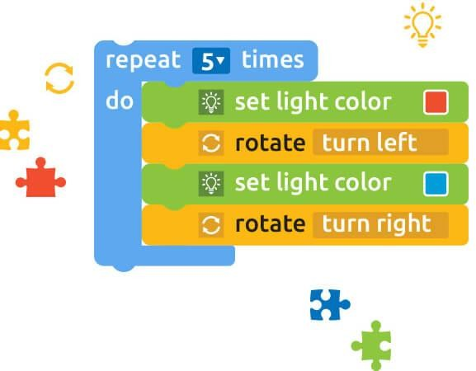
What is programming and block coding?
Programming
Block Coding
❏ Simpliﬁed programming language.
❏ Great for beginners
❏ Drag and drop
❏ Set of instructions for a computer to execute a certain task(s)
❏ Why program? Computers are faster than humans and more eﬃcient.
❏ Examples of programming languages are (Java, C#, Python, Javascript, Ruby)
❏ Convert algorithms into code
Notes:
Pink- Need Secondary title? Might be confusing for outsiders (do it) add program picture left

Slide 4
Mission
❏ Developing an easier way to teach programming fundamentals (loops, functions,
if-statements)
❏ Spread interest, and knowledge about Information Technology
❏ Break down popular culture stigma around programming: (hacking scenes)
❏ Using a familiar activity to accelerate learning in programming

Slide 5
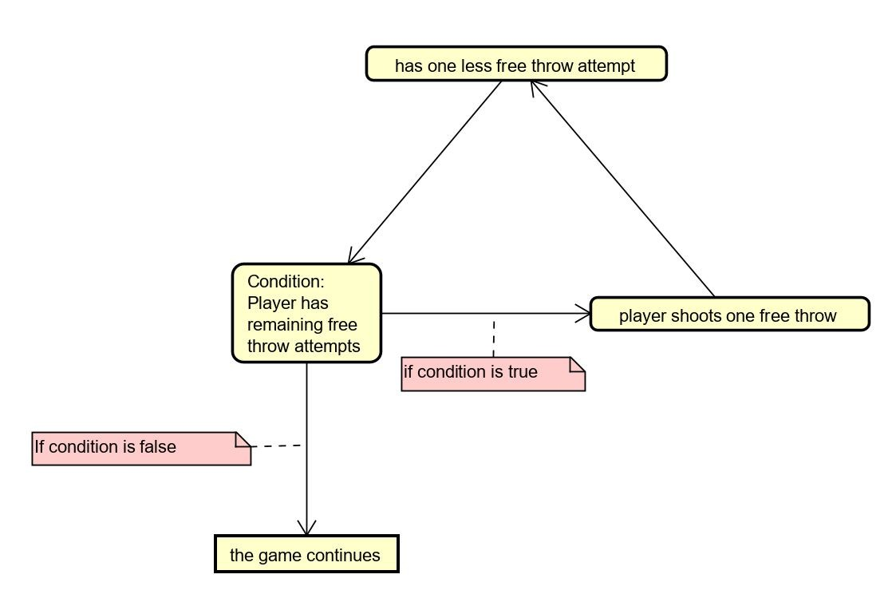
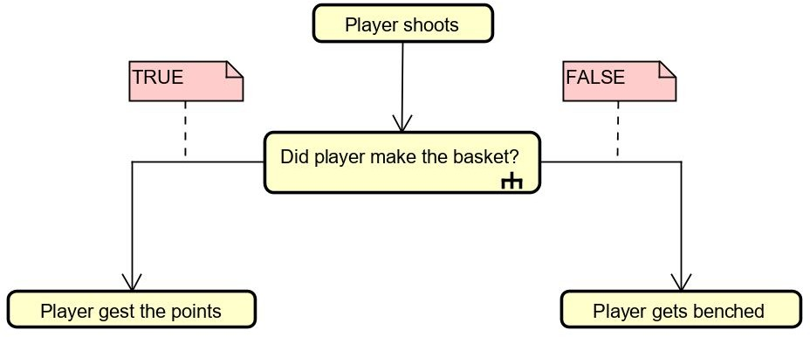
If / Else, Loops, Functions
If/Else Loop

Slide 6
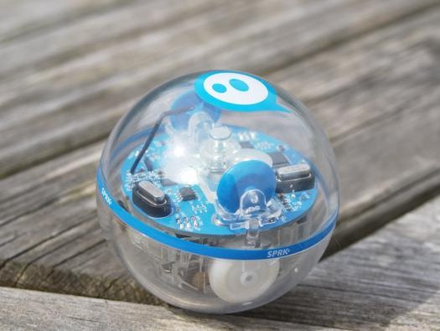
Our Technology
A programmable robot sphere that can spin, glow diﬀerent colors, and detect whether it is falling or has hit something.

Slide 7
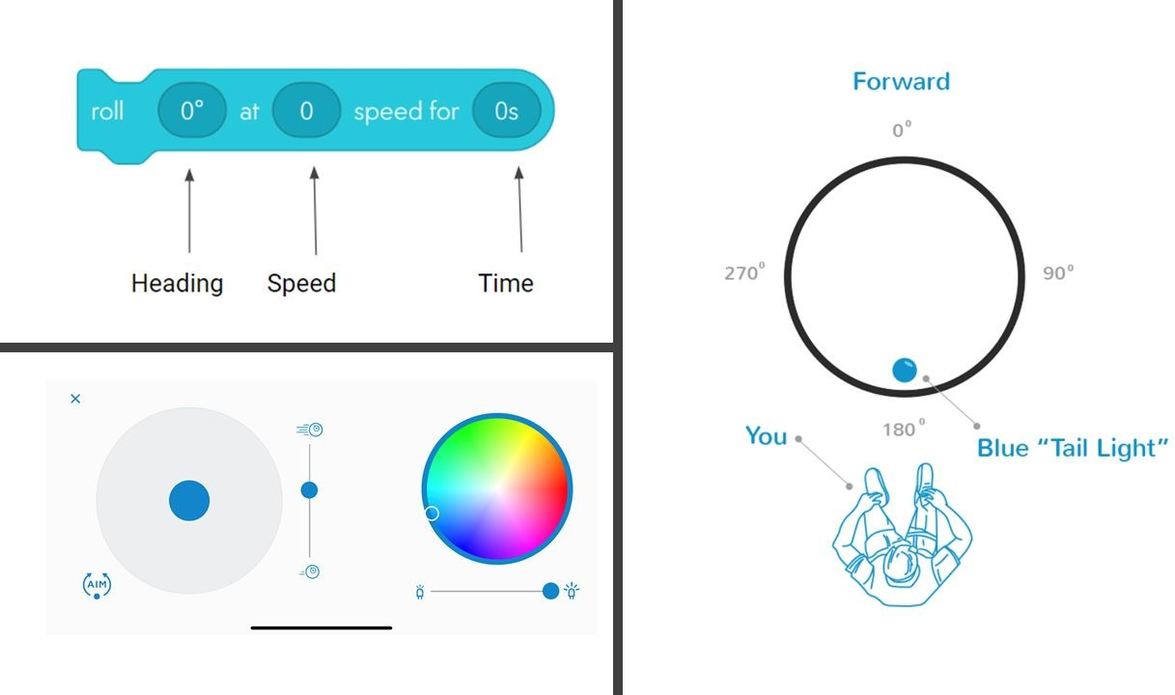
Moving with Code
Manual Movement

Slide 8
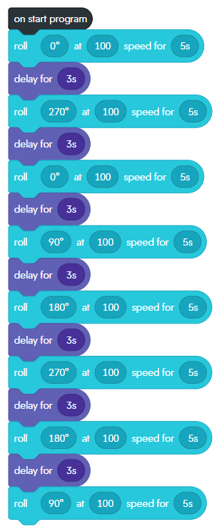
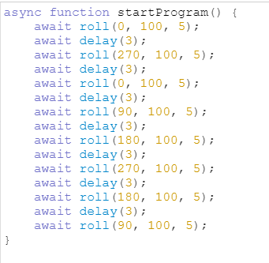
Block Code vs Scripting

Slide 9
Split Into Groups
Notes:
Split the groups before robots handed out

Slide 10
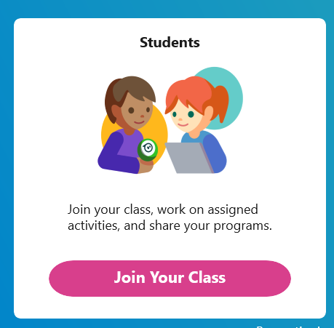
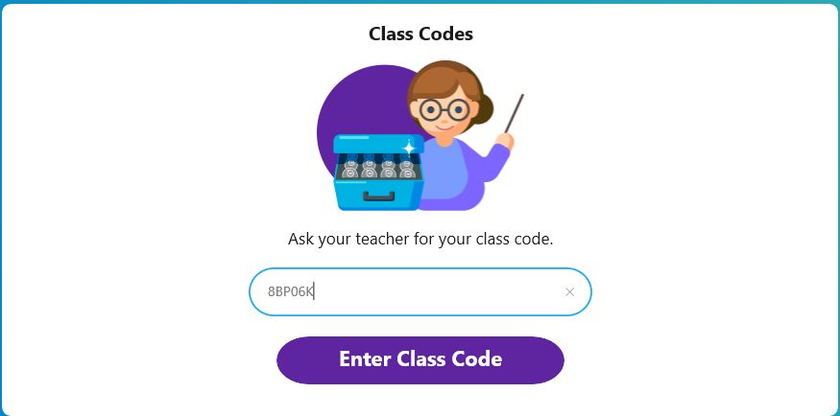
Join The Class
Notes:
Username: tlam8
Password: BallIsLife (capital i)

Slide 11
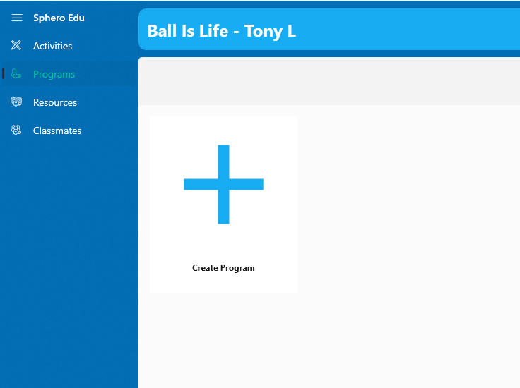
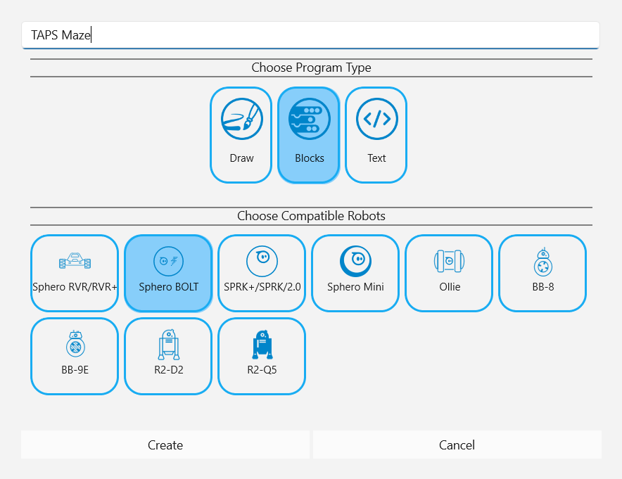
Create a new program

Slide 12
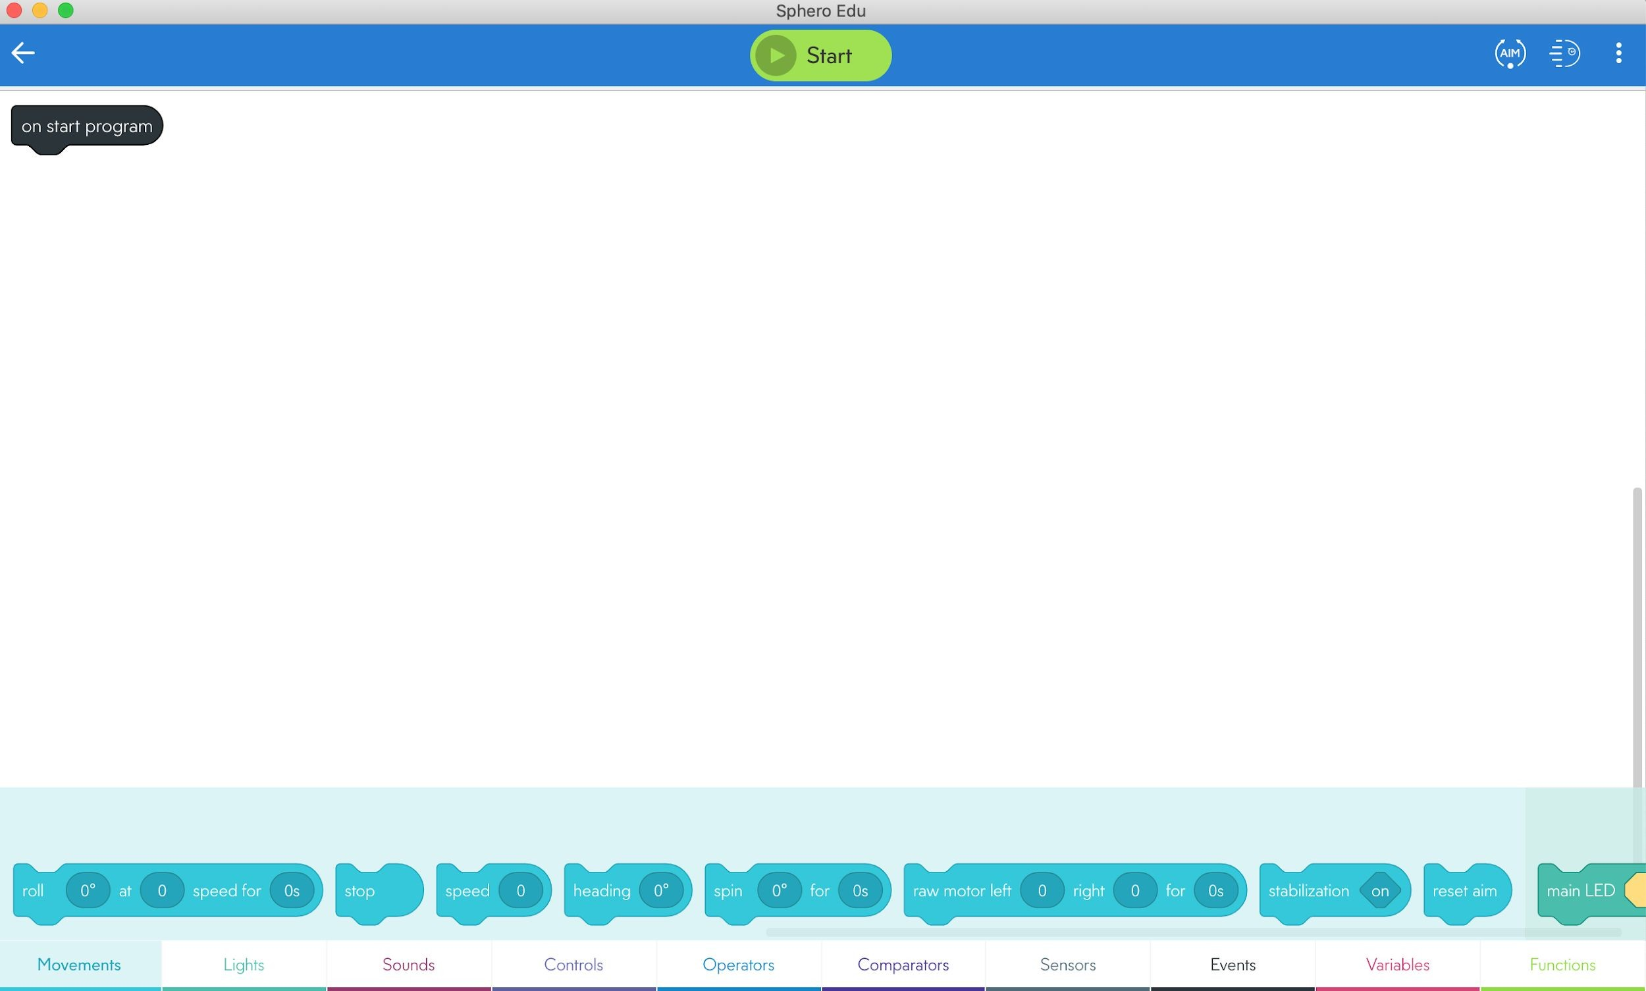
Welcome to the Canvas

Slide 13
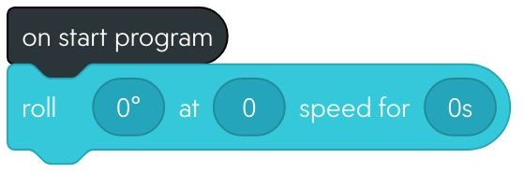
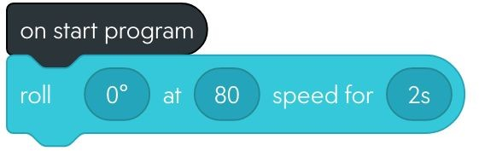
Make Sphero move Forward
❏ Click on movements tab
❏ Drag Roll function onto canvas
❏ Adjust parameters

Slide 14
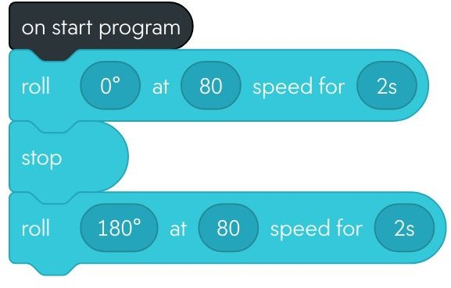

Now Backwards
❏ Adjust the ﬁrst box to allow Sphero to change direction
Notes:
Yellow – leave or change? Should be more specific? They already have answer on screen.

Slide 15
Now you try!
Notes:
Split the groups before robots handed out

Slide 16
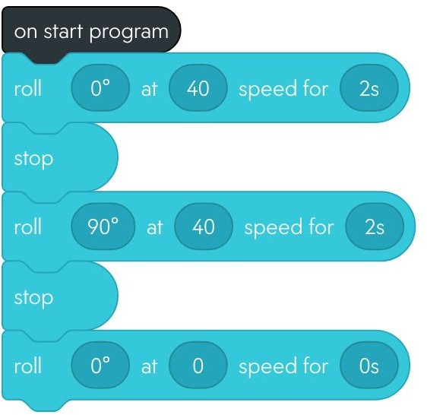
Let's make a Square
❏ Using what we have here, can you ﬁnish the square?

Slide 17
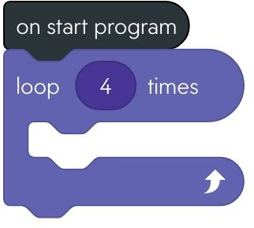
Using loops to make a Square
❏ Grab the loop block under Controls

Slide 18
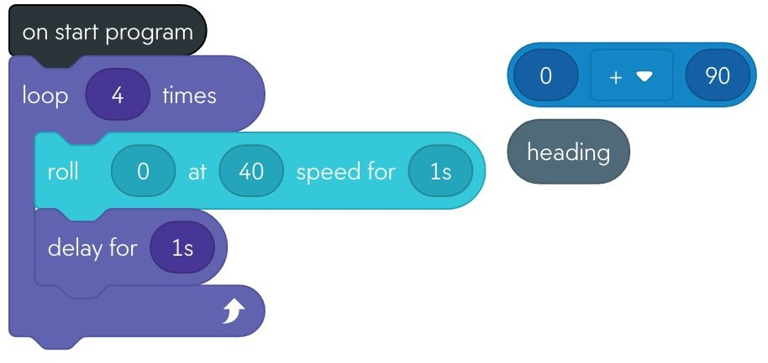
Loops
❏ Now grab the roll block and
insert it into the loop
❏ Grab the addition block from under operators
❏ Grab heading block from under sensors

Slide 19
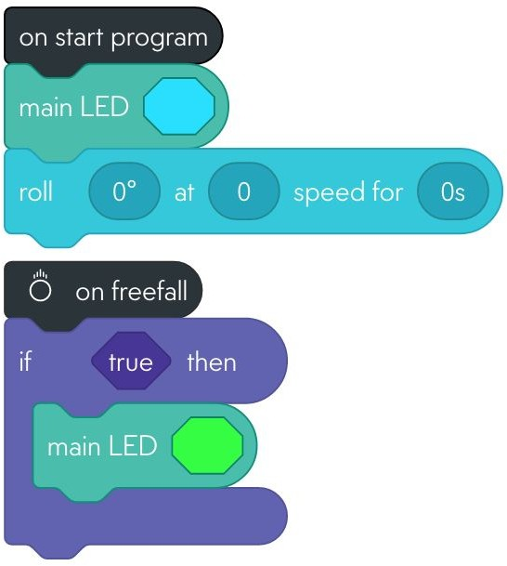
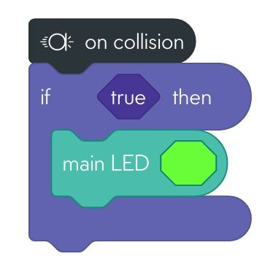
If Else
❏ Under the events tab drag on freefall to the canvas
❏ on freefall will run alongside on start program
❏ If the Sphero falls it will turn from blue to green
Notes:
Yellow –Second bullet point little confusing

Slide 20
Challenge!
❏ Create your own program!
❏ Grab cones and ramps
❏ Team with most creative program wins!

